Slide 1
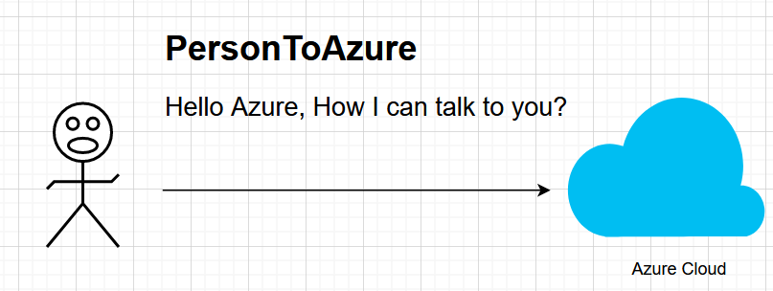
Let see story of a person who want to use Cloud

Slide 2
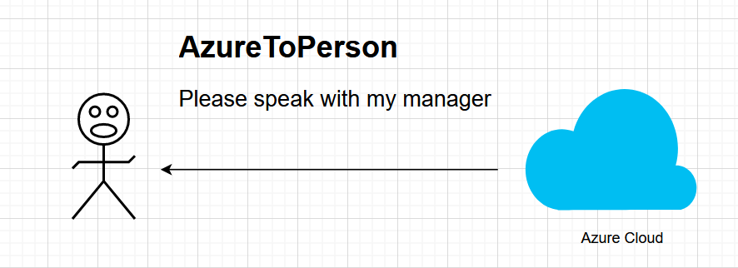
AzureReply: Talk to my manager

Slide 3
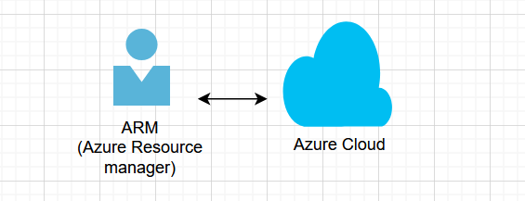
ARM[Azure resource manager]

Slide 4
Azure resource manager
Link: https://learn.microsoft.com/en-us/azure/azure-resource-manager/management/overview

Slide 5
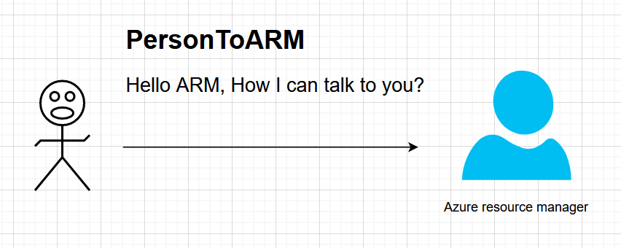
Person to ARM

Slide 6
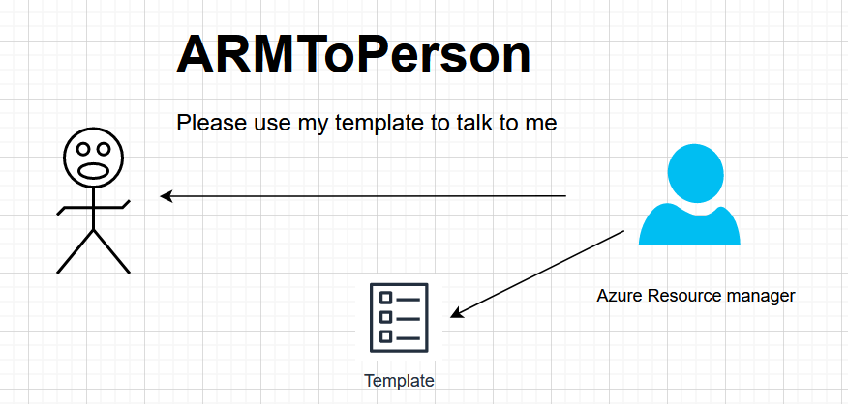
Please speak with me in my teamplate

Slide 7
ARM template
ARM templates are written in JSON (JavaScript Object Notation) and are used to define and deploy resources into the Microsoft Azure cloud platform.
https://learn.microsoft.com/en-us/azure/azure-resource-manager/templates/overview

Slide 8
Lets see one template for creating VM
https://github.com/JanbaskDevops/Batch1/tree/main/AzureCloud/Azure%20Zero%20to%20Hero/Azure-zero-to-hero-repository/Day-11%20ARM%20template/02-virtual-machine

Slide 9

My face after seeing ARM template to ARM manager

Slide 10

ARMToPerson

Slide 11

You just wait I am coming

Slide 12
we don't support violence

Slide 13

PersonToARM: Don’t try anything

Slide 14
ARMtoPerson: Why what’s problem in ARM?
If I know that much codding, I would be working in google.

Slide 15

You need to tell me that you don’t know codding

Slide 16
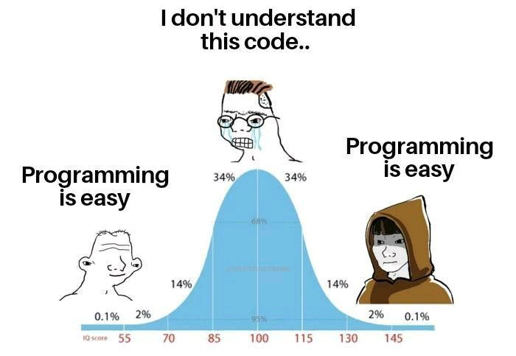
Let me tell you now> I don’t know codding

Slide 17
I have 2 more way for you
Manual
Azure CLI
Here, I will write ARM template, you can start using them.
Live Demo: How ARM template provided for automation.

Slide 18

PersonToAzure

Slide 19
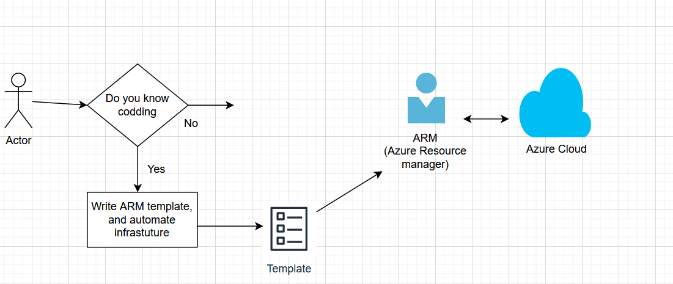
What if I know codding

Slide 20
Codding helping assistant
Visual Studio is an integrated development environment developed by Microsoft. It is used to develop computer programs including websites, web apps, web services and mobile apps.
https://code.visualstudio.com/download

Slide 21
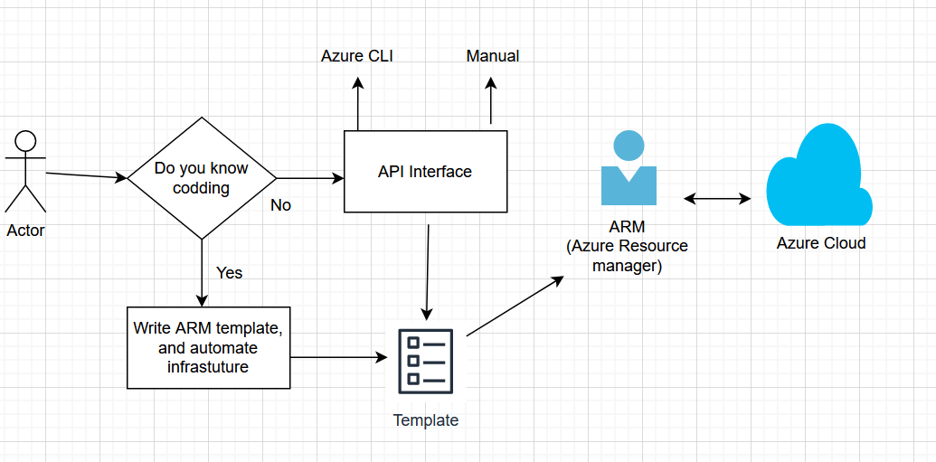
Azure Cloud Infrastructure

Slide 22

Do you think it’s happy ending?

Slide 23
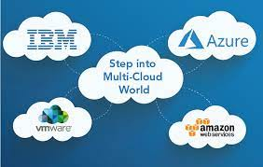
No, architect decide we will use hybrid cloud

Slide 24

I am Thinking for my architect and talking to myTeam

Slide 25

Mean while my Seniors

Slide 26
Reason for using multicloud
Taking expertise of cloud’s in their area like-
Google: Good for Storage
AWS: Very good documentation
IBM: Good for mainframe application
Oracle: Good for Java based application

Slide 27

My situation

Slide 28

Terraform

Slide 29
Terraform
You just learn copy paste, and I will help you to create infrastructure in 4000+ cloud

Slide 30
What is Terraform?
Multi cloud management tool
Good Points:
1) Very nice documentation.
2) Structured things

Slide 31

People who don’t know terraform

Slide 32
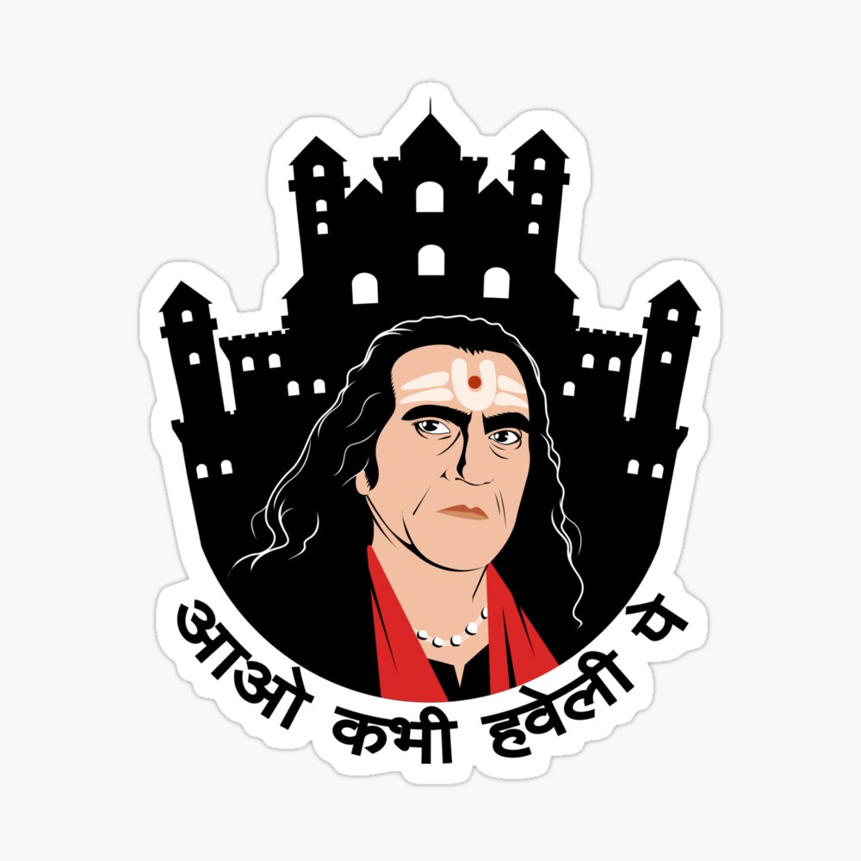
Terraform to all

Slide 33

Story to be continue-

Slide 34
Next 3 days Agenda
Storage and manual cloud management
CLI and virtual machine
Terraform and AzureWebApp

Slide 35
Note
Cloud is very boring, just trying to get your interest, Please share your feedback

